Slide 1
IMDB MOVIE REVIEWS ANALYSIS
EDUNET FOUNDATION FINAL PROJECT
Presented By:
Name: AYUSH DUTTA
Internship ID:INTERNSHIP_171273103266163398a8c87
AICTE Student ID:STU6640d104320f31715523844
Institute: BENGAL ENGINEERING AND SCIENCE UNIVERSITY, SHIBPUR
Degree: BACHELOR OF TECHNOLOGY (4YEARS UG PROGRAM)
Student’s Email ID: dutta7759@gmail.com

Slide 2
OUTLINE
Problem Statement
Proposed System/Solution
System Development Approach
Algorithm & Deployment
Result
Conclusion
Future Scope
References
IBM SKILLSBUID course completion certificate

Slide 3
Problem Statement
A Movie dataset for binary sentiment classification containing substantially more data than previous benchmark datasets. We are provided with a set of 50,000 highly polar movie reviews for training and for testing. So, predict the number of positive and negative reviews using either classification or deep learning algorithms.

Slide 4
Proposed Solution
The proposed system aims to address the challenge of sentiment classification for IMDb movie reviews, predicting whether a review is positive or negative. This involves leveraging data analytics and machine learning techniques to accurately classify sentiments based on textual reviews. The main concept used during solving this problem was LOGISTIC REGRESSION CONCEPT . The solution will consist of the following components:
Data Collection:
- Gather a dataset of IMDb movie reviews labeled with sentiments (positive or negative).
- Include metadata such as review text, sentiment label, and potentially additional features like movie genre, release year, etc.
Data Preprocessing:
- Clean and preprocess the collected data to handle text-specific challenges such as punctuation, stopword , and capitalization.
- Perform tokenization and vectorization of text data using techniques like TF-IDF to convert text into numerical features suitable for machine learning models.
Machine Learning Algorithm:
- Implement a classification algorithm, such as Logistic Regression, to predict sentiment labels based on the processed text features.
- Explore deep learning techniques, such as LSTM (Long Short-Term Memory) networks, for capturing sequential dependencies in reviews for potentially improved performance.

Slide 5
Proposed solution
Deployment:
- Develop a user-friendly interface or application that allows users to input a movie review and receive real-time sentiment predictions (positive or negative).
- Deploy the solution on a scalable and accessible platform, ensuring robust performance and user responsiveness.
Evaluation:
- Assess the model's performance using standard metrics like accuracy, precision, recall, and F1-score.
- Validate the model's generalization capability using cross-validation techniques and consider fine-tuning parameters to optimize performance.
Result:
The system aims to provide an effective tool for sentiment analysis of IMDb movie reviews, enabling users to gauge audience reactions accurately. By integrating data preprocessing, machine learning algorithms, and user-friendly deployment, the solution seeks to enhance decision-making in the entertainment industry, facilitating informed strategies for movie marketing, production, and audience engagement.

Slide 6
System Approach
SYSTEM REQUIREMENTS-
1.A standard laptop or desktop computer with at least 8GB of RAM and a multi-core CPU.
2.Adequate storage capacity for storing datasets and model artifacts.
3.Python 3.x: The programming language used for development.
4.Integrated Development Environment (IDE) like Jupyter Notebook or PyCharm for coding and experimentation.
5.Package management system (pip or conda) for installing necessary Python libraries.

Slide 7
SYSTEM APPROACH
LIBRARIES USED-
Pandas: Data manipulation and analysis library for handling datasets effectively.
Scikit-learn: Machine learning library providing tools for data mining and data analysis. It includes various classification, regression, and clustering algorithms.
Matplotlib: A comprehensive library for creating static, animated, and interactive visualizations in Python.
Seaborn: A data visualization library based on Matplotlib, providing a high-level interface for drawing attractive and informative statistical graphics.

Slide 8
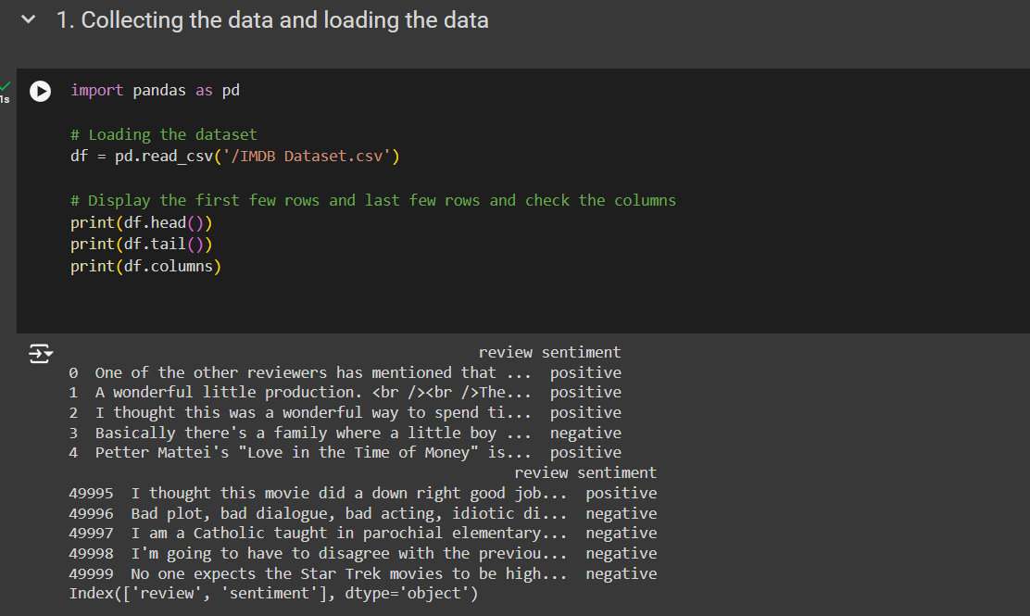
Algorithm & Deployment
THE BASIC ALGORITHM USED IS LOGISTIC REGRESSION.
Logistic regression is a statistical method used for binary classification, predicting the probability of a binary outcome based on input features. It models the relationship between the categorical dependent variable and one or more independent variables by estimating probabilities using a logistic function.

Slide 9
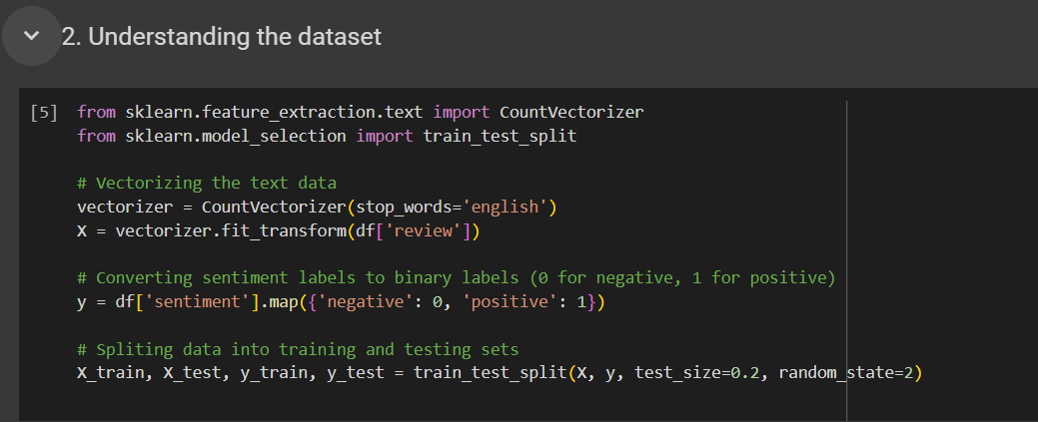
ALGORITHM & DEPLOYMENT

Slide 10
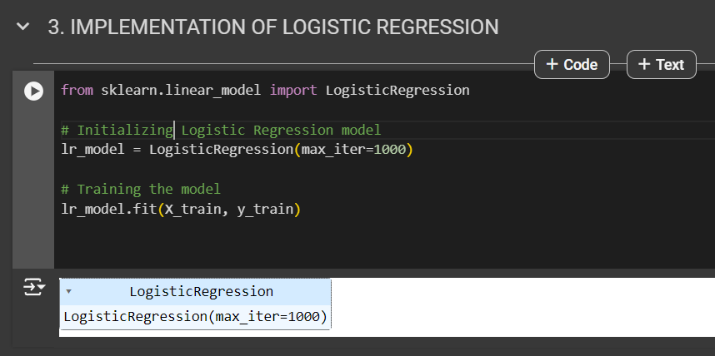
ALGORITHM & DEPLOYMENT

Slide 11
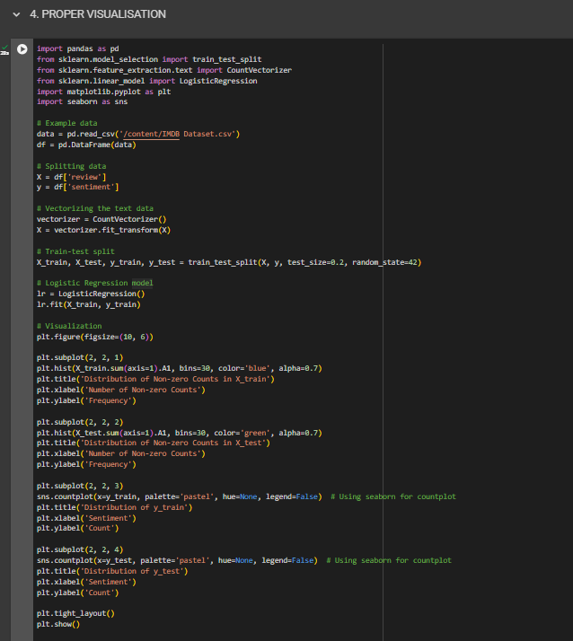
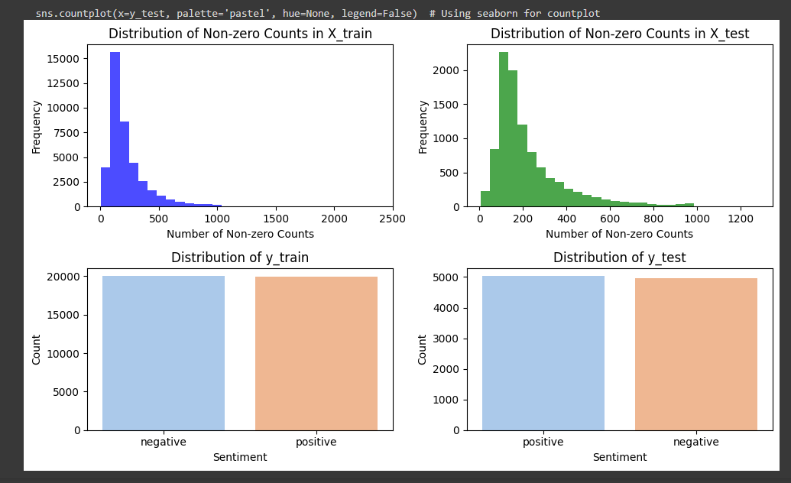
Result

Slide 12
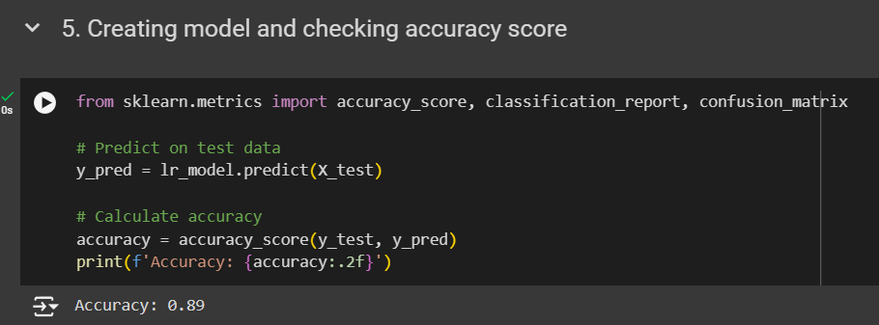
Result
ACCURACY ACHIEVED IS 89 %

Slide 13
RESULT
The reason for achieving 89% accuracy instead of 100% is primarily due to the significant variation in people's opinions about movies. Movie ratings are inherently subjective, influenced by individual preferences, cultural backgrounds, and personal experiences. This variability makes it challenging for any model to predict ratings with absolute certainty for every user and every movie. While the analysis may effectively capture trends and patterns in the data, the diversity of opinions among users means that some predictions will inevitably differ from actual ratings, leading to a maximum achievable accuracy that is less than perfect.

Slide 14
Conclusion
The IMDb movie sentiment classification project aimed to develop a robust system for analyzing and predicting sentiments from movie reviews. Leveraging data analytics and machine learning techniques, the project involved collecting a dataset of IMDb movie reviews, preprocessing the data to handle text-specific challenges, and implementing a sentiment classification model using logistic regression and TF-IDF vectorization.
Key achievements included evaluating the model's performance with metrics like accuracy, precision, recall, and F1-score, achieving satisfactory results in classifying reviews into positive and negative sentiments. Visualizations using Matplotlib and Seaborn enhanced the interpretability of results, providing actionable insights for stakeholders in the entertainment industry.
The project highlighted the effectiveness of machine learning in understanding audience reactions and sentiments, offering a valuable tool for improving movie marketing strategies, production decisions, and overall audience engagement. Future enhancements could explore advanced natural language processing techniques and real-time data integration to further refine prediction accuracy and relevance in dynamic movie review landscapes.
Overall, the IMDb movie sentiment classification project demonstrated the potential of data-driven approaches to transform sentiment analysis in the entertainment industry, paving the way for informed decision-making and strategic insights.

Slide 15
FUTURE SCOPE
Real-Time Data Integration: Incorporate real-time data sources such as social media trends
and audience interactions to enable dynamic sentiment analysis and responsive insights.
Multilingual and Cross-Cultural Analysis: Extend sentiment analysis capabilities to handle
diverse languages and cultural contexts, enhancing applicability and insights across global audiences.
Integration with Recommendation Systems: Integrate sentiment analysis insights into movie
recommendation systems to personalize user experiences based on sentiment preferences and enhance engagement.
Enhanced Visualization and Interpretation: Develop interactive visualization tools to present
sentiment analysis results intuitively, including sentiment trends, genre-based insights, and comparative analyses.
Expansion to Other Entertainment Domains: Apply the developed methodologies and models to
analyze sentiments in other entertainment domains such as TV shows, streaming content,
and music reviews, adapting approaches to domain-specific characteristics and trends.

Slide 16
References
1. IBM SKILLSBUILD PLATFORM
2. IBM CLOUD
3.JUPYTER NOTEBOOK
4.GOOGLE COLLAB
5. KAGGLE WEBSITE FOR DATASET
6. EDUNET ONLINE EDUCATION 4 WEEK TRAINING PROGRAM

Slide 17
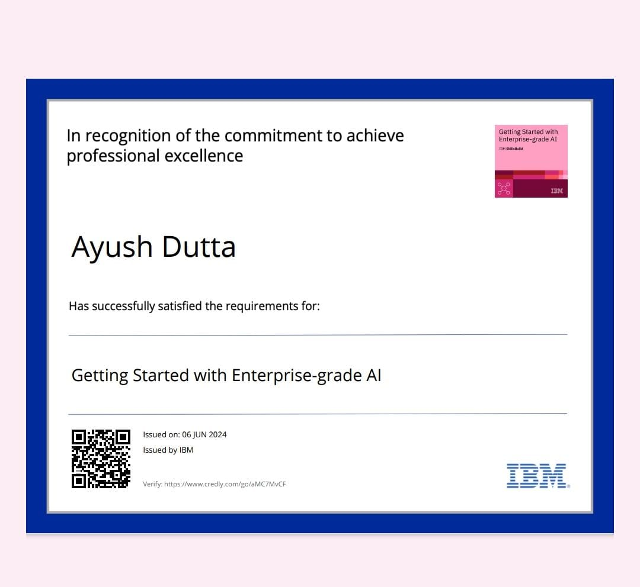
IBM SKILLSBUILD COURSE COMPLETION CERTIFICATE 1:

Slide 18
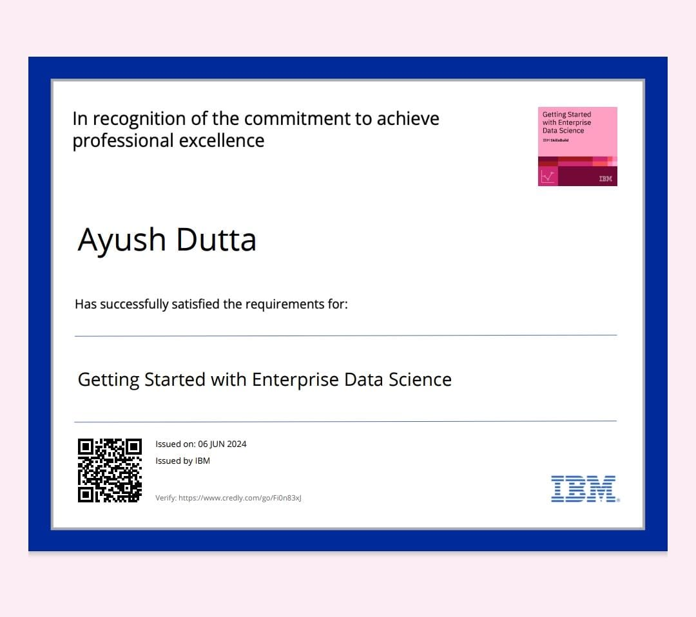
IBM SKILLSBUILD COURSE COMPLETION CERTIFICATE 2:

Slide 19
THANK YOU
Presented By:
Name: AYUSH DUTTA
Internship ID:INTERNSHIP_171273103266163398a8c87
AICTE Student ID:STU6640d104320f31715523844
Institute: BENGAL ENGINEERING AND SCIENCE UNIVERSITY, SHIBPUR
Degree: BACHELOR OF TECHNOLOGY (4YEARS UG PROGRAM)
Student’s Email ID: dutta7759@gmail.com

